Slide 1

EXPLAINABLE REAL TIME SIGN LANGUAGE TO TEXT TRANSLATION
Team Members:
Mawejje Mark William
Katende Jericho
Musemeza Murungi Isaac
Presented by -
Group CS24-22
Affiliation: -
Makerere University
Country: Uganda
Link to the video presentation

Slide 2
Contents of Presentation
Introduction
Problem Statement
Related works
Research Questions and Objectives
Research Contributions
Methodology / System Architecture
Images
Conclusions
Limitations
Acknowledgment

Slide 3
Problem Statement
There is little understanding and contact between the Deaf and Hard of Hearing (DHH) community and spoken language users due to a significant communication gap. The majority of hearing people do not have a basic understanding of sign language, which exacerbates this disparity [2].
This issue is made worse by the black box nature of existing machine learning models for sign language translation; these models provide no insight into the decision-making process [3]. As a result, it gets harder to put creative ideas into practice that try to close the communication gap.
Novel solutions that put the needs of the Deaf and Hard of Hearing Community first in terms of transparency and comprehension are desperately needed in order to solve the communication problems that they encounter.

Slide 4
Introduction
Sign languages play a crucial role in the cognitive and social development of the Deaf and Hard of Hearing (DHH) community [1]. Despite its importance, a communication barrier persists, hindering access to essentials like healthcare and education.In this report we implement an Explainable Real-Time Sign Language Translation model. The primary goal was to develop a transparent system for translating sign language into text, addressing the transparency and documentation issues in current SLR systems.

Slide 5
Research Questions and Objectives
Research questions | Research Objectives
How can we ensure model transparency and interpretability? | To design and train interpretable sign-to-text machine translation models using advanced machine-learning techniques
How can we focus on fluid conversations and user feedback for continuous improvement? | To implement, assess, and refine the sign-to-text machine translation models for real-time communication.
How can we achieve the user interaction and intuitiveness of our model? | To incorporate the developed model into a mobile application that is user-friendly and accessible to its users.

Slide 6
Research Contributions
Development of an Explainable Real-Time Sign Language to Text Translation System
Employed deep learning techniques and multiple interpretability methods, including SHAP, Grad-CAM, and LIME.
Creation of a User-Friendly Mobile Application for Accessible Sign Language Translation
Integration of the trained translation model into a mobile application.

Slide 7
Contributions
Promotion of Inclusive Communication and Accessibility
Bridged the communication gap between the DHH community and the hearing population which can empower the DHH community to participate fully in various aspects of society.
Establishment of a Foundation for Future Research and Innovations
Adoption of a responsible and transparent approach to AI development.
Paved the way for further advancements and widespread adoption of inclusive communication technologies.
Provided a solid foundation for future research in the field of sign language translation.

Slide 8
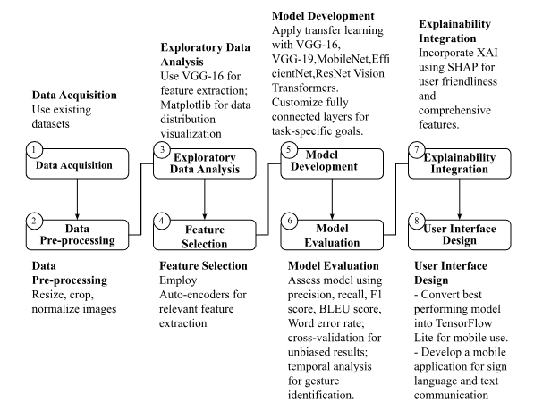
Methodology

Slide 9
METHODOLOGY
Main Step | Sub-Step | Details
Data Acquisition | Primary Datasets | 1) Lexset Synthetic ASL Alphabet Dataset
 | Lexset Dataset | - 27,000 images of ASL alphabet signs 512x512 pixel resolution
 | Training Set | - 27 folders, 900 examples each Additional folder for random backgrounds
 | Test Set | - 27 folders, 100 examples each Additional folder for random backgrounds
 | WLASL (World Level American Sign Language) Video | - 12,000 videos of sign language expressions Rich resource for model training and evaluation
Data Preprocessing | Normalization | Rescaled pixel values from 0-255 to 0-1 using ImageDataGenerator
 | Resizing | - Images resized to 224x224 pixels for CNN input
 | Batching | - Data organized into batches of 32 images

Slide 10
Continuation
Model Implementation | Convolutional Neural Networks (CNNs) | - Built using Keras Sequential API
 | CNN Architectures | - VGG-16 and VGG-19 Convolutional, max-pooling, and fully connected layers - Used for feature extraction and classification
 | Vision Transformers (ViT) | - Self-attention mechanism inspired by Transformer architecture - Input images split into patches - Series of Transformer encoder layers to capture global dependencies
Model Training | VGG-19 Training | - Initialized with pre-trained ImageNet weights (transfer learning) - Adam optimizer, sparse categorical cross-entropy loss - Trained for 15 epochs with checkpointing - Evaluated on validation data after each epoch
 | Vision Transformer Training | - Pre-trained ViT-Base model loaded - Similar training procedures as CNNs

Slide 11
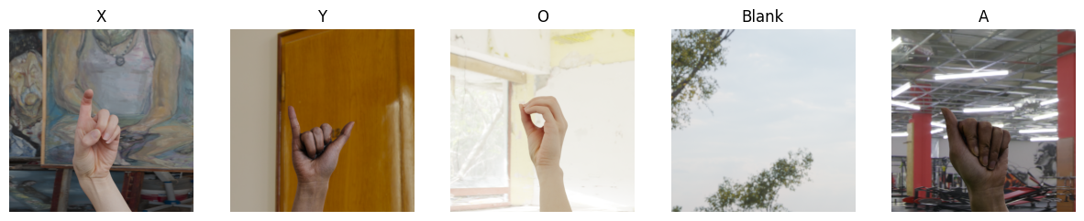
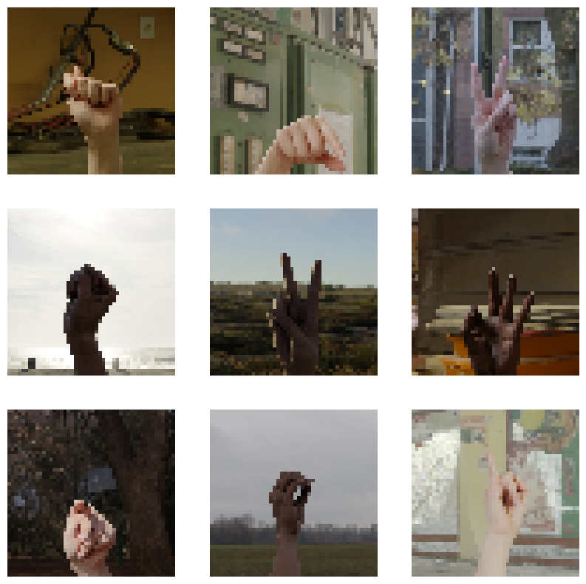
Dataset images
Augmented Images

Slide 12
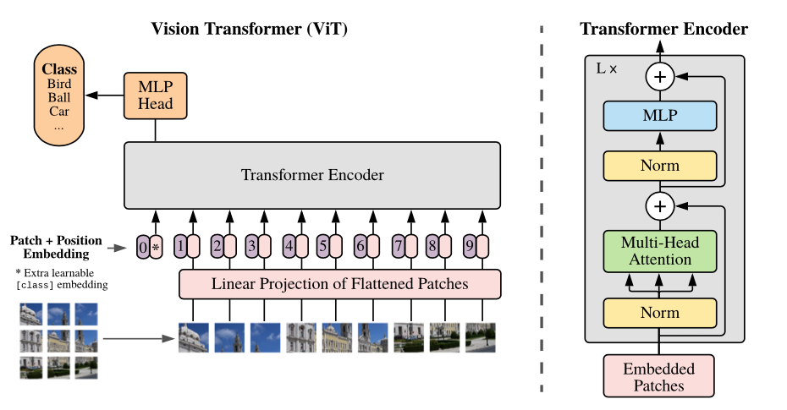
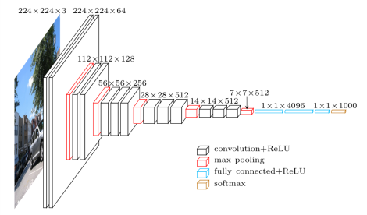
Model Architectures
vgg-19

Slide 13
Explainability
Explainability Model | Description
LIME (Local Interpretable Model-agnostic Explanations) | -Creates local surrogate models that can be used to explain individual predictions of the original black-box model. -It identifies significant features or super-pixels in an input image, training a local sparse linear model around the instance of interest and providing visual heatmaps or feature importance scores.
SHAP (SHapley Additive exPlanations) | -The model assigns a Shap value to each input feature, ensuring fair distribution of contributions across all features. -It provides a comprehensive understanding of the model's behavior by quantifying the impact of each input feature on the output prediction.
Grad-CAM (Gradient-weighted Class Activation Mapping) | - Computes the gradients of the target class score with respect to the final convolutional layer's feature maps and weights the feature maps using the computed gradients to identify the regions of the input image that have a significant influence on the model's prediction and generates visual heatmaps that highlight the important regions in the input image that contributed to the model's decision, providing a spatial understanding of the model's focus.
Integrated Gradients | The model's prediction is attributed to its input features by computing output gradients along a path from a baseline to the input instance. An attribution map highlights the importance of each pixel in the input image for the model's prediction. This provides a fine-grained explanation of the model's behavior, showing how different components of the input image influence the final decision.

Slide 14
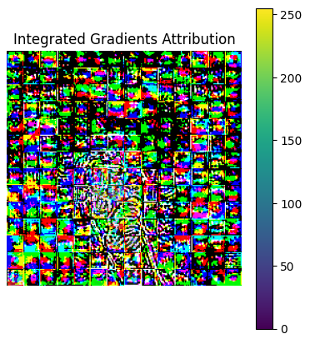
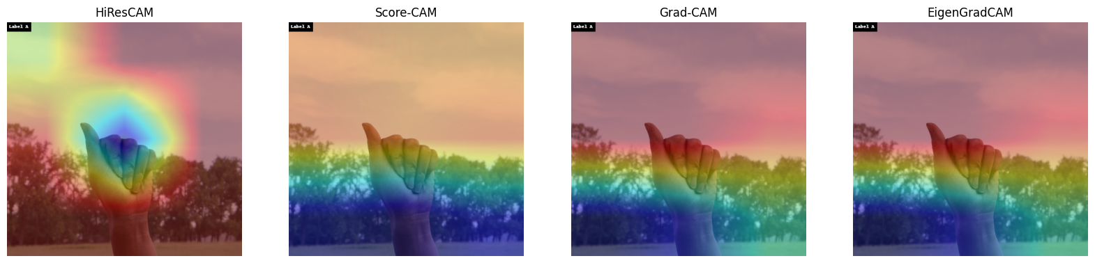
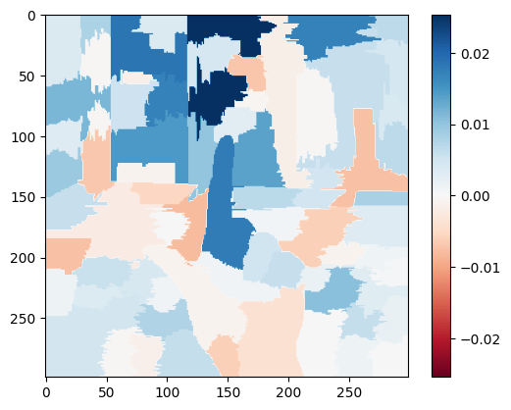
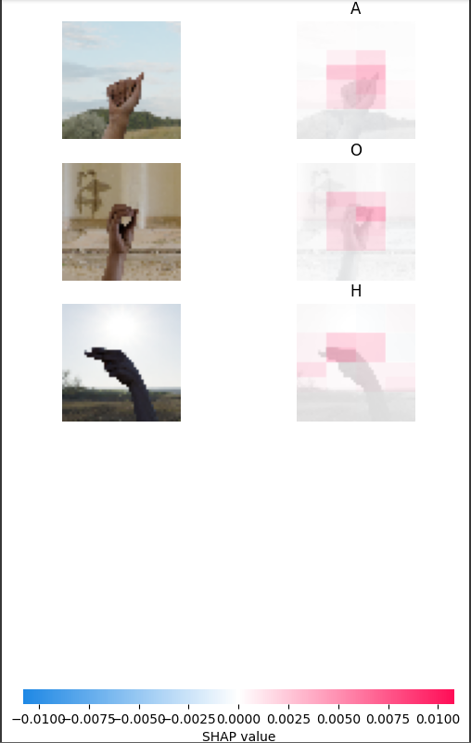
EXPLAINABILITY
GRADCAM
Shap value
LIME value

Slide 15
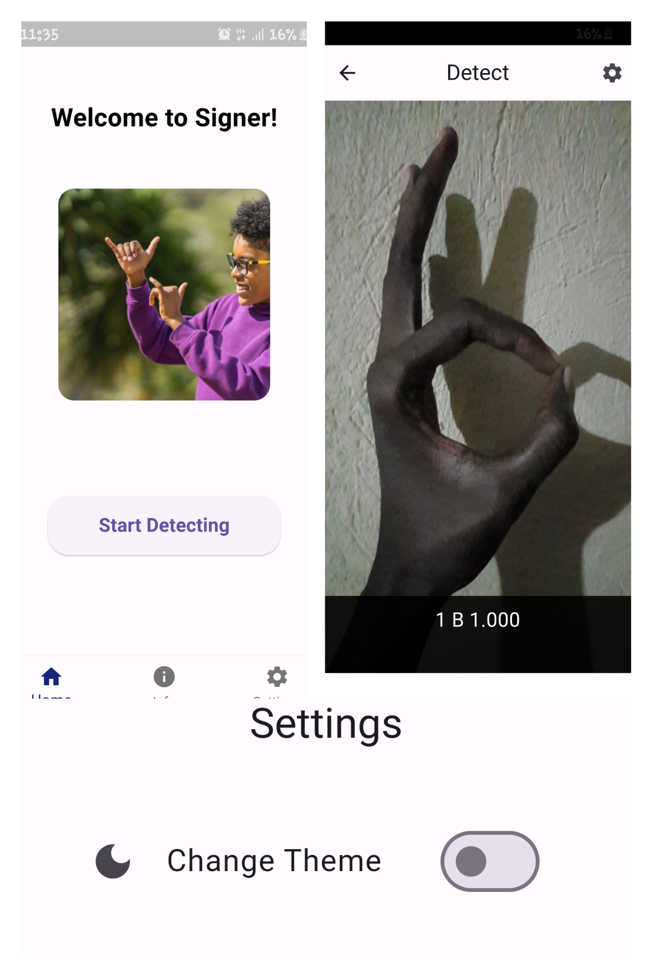
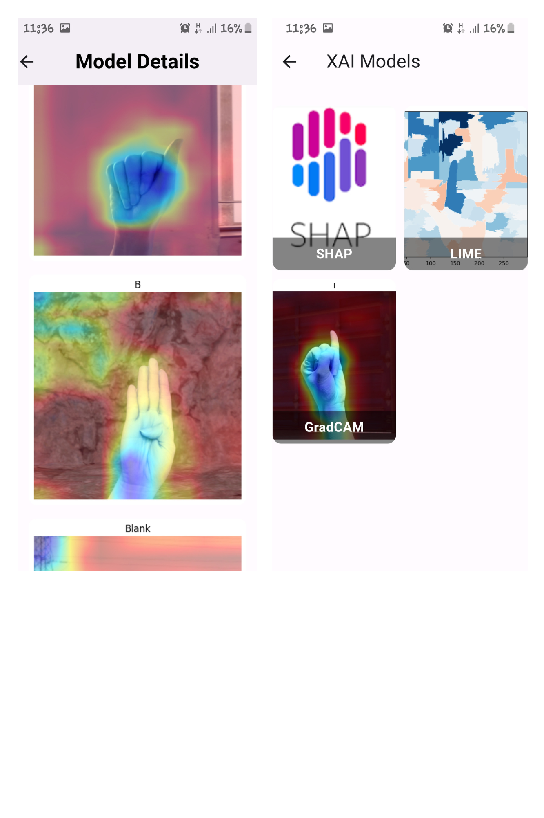
Mobile Application

Slide 16
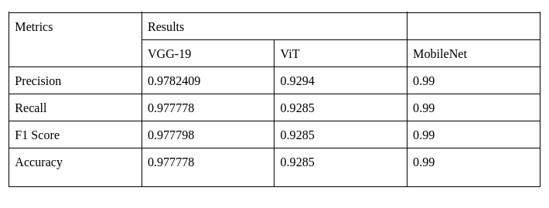
SUMMARY OF TWO BEST PERFORMING MODELS

Slide 17
Limitations
The research faced limitations due to limited datasets and computational resources.
The video-based dataset was not utilized fully, limiting the understanding of dynamic sign language recognition. The absence of a Ugandan Sign Language dataset was a significant challenge, as it required rigorous regulatory and procedural requirements. This hindered the model's application in Uganda, limiting its scope and applicability.
The limitations underscore the need for improved computational resources and the development of region-specific datasets to advance research in sign language recognition effectively.

Slide 18
Conclusions
We aimed at improving the accuracy and explainability of a real-time sign language-to-text model using a high-quality dataset. MobileNet outperformed expectations with greater accuracy, precision, and recall rates, and demonstrated efficiency in dealing with complex visual patterns.
Techniques like SHAP, LIME, and Grad-CAM were employed to understand the model's decision-making process. The model was translated to TensorFlow Lite (TFLite) and integrated into a mobile application, bridging the gap between theoretical study and practical application.
Future works include broadening the dataset to include various sign languages, geographical variances, and complicated motions, real-time performance optimization, multimodal integration, and creating a Ugandan sign language dataset.

Slide 19
Acknowledgements
We would like to express our profound gratitude to the Makerere University community as well as the School of Computing and Information Technology for their unwavering support. We also thank Mr. Ggaliwango Marvin, our supervisor, for his advice.

Slide 20
References
[1] W. Aly, S. Aly, and S. Almotairi, “User-Independent American Sign Language Alphabet Recognition Based on Depth Image and PCANet Features,” IEEE Access, vol. 7, pp. 123138–123150, 2019, doi: https://doi.org/10.1109/access.2019.2938829.
[2] J. Bora, Saine Dehingia, Abhijit Boruah, Anuraag Anuj Chetia, and Dikhit Gogoi, “Real-time Assamese Sign Language Recognition using MediaPipe and Deep Learning,” vol. 218, pp. 1384–1393, Jan. 2023, doi: https://doi.org/10.1016/j.procs.2023.01.117.
[3] A. Barredo Arrieta et al., “Explainable artificial intelligence (XAI): Concepts, taxonomies, opportunities and challenges toward responsible AI,” Information Fusion, vol. 58, no. 1, pp. 82–115, Jun. 2020, doi: https://doi.org/10.1016/j.inffus.2019.12.012.
[4] K. Sharma, Kunwar Abhayjeet Aaryan, Urvashi Dhangar, R. P. Sharma, and S. Taneja, “Automated Indian Sign Language Recognition System Using LSTM models,” 2022 International Conference on Computing, Communication, and Intelligent Systems (ICCCIS), Nov. 2022, doi: https://doi.org/10.1109/icccis56430.2022.10037711.
[5] T. Starner, J. Weaver, and A. Pentland, “Real-time American Sign Language recognition using desk and wearable computer based video,” IEEE Transactions on Pattern Analysis & Machine Intelligence, vol. 20, no. 12, pp. 1371–1375, Dec. 1998, doi: https://doi.org/10.1109/34.735811.
‌

